Slide 1
HEALTHY HARVEST
-plant disease detection and remedies

Slide 2
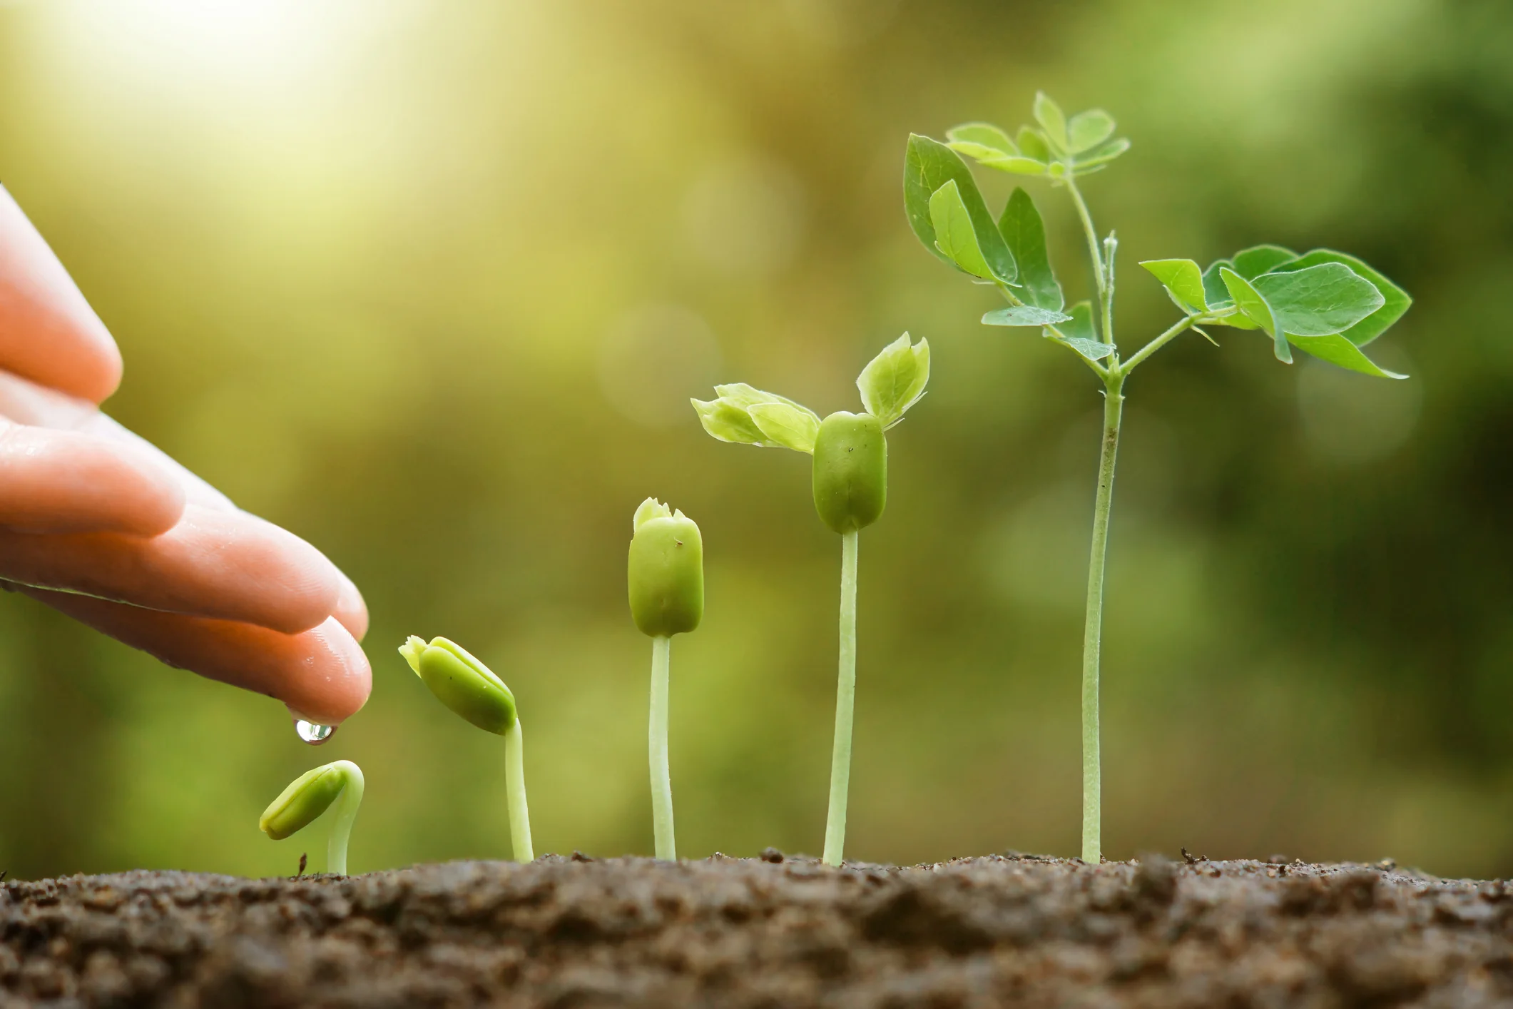
Introduction:
Plant diseases cause significant crop damage, leading to economic losses for farmers and food shortages. Traditional disease detection methods are often inefficient, expensive, and inaccurate. There has been growing interest in deep learning, particularly Convolutional Neural Networks (CNNs), to create automated plant disease detection systems. Our system, trained on 20,636 images encompassing 3 plant species and 15 diseases, achieved 91% accuracy on the validation set and 89% on test set. This demonstrates the power of using deep learning in plant disease detection.

Slide 3
Literature Survey
S. P Mohanty, D. P Hughes, and Marcel Salath´e.“Using deep learning for image-based plant disease detection”.In: Frontiers in plant science 7 (2016), p. 1419
P. V,Rahul Das,and V. Kanchana , “Identification of Plant Leaf Diseases Using Image Processing Techniques” 978-1-5090-4437 5/17/$31.00 ©2017 IEEE International Conference on Technologic Innovations in ICT For Agriculture and Rural Development.
Plant Leaf Diseases Detection and Classification Using Image Processing and Deep Learning Techniques-IEEE 2020
Previous studies in plant disease detection faced several limitations, including lower accuracy, limited scalability to various plants and diseases, sensitivity to background and lighting variations, lack of real-time detection capabilities, inadequate evaluation metrics, and complex implementation that hindered user adoption.

Slide 4
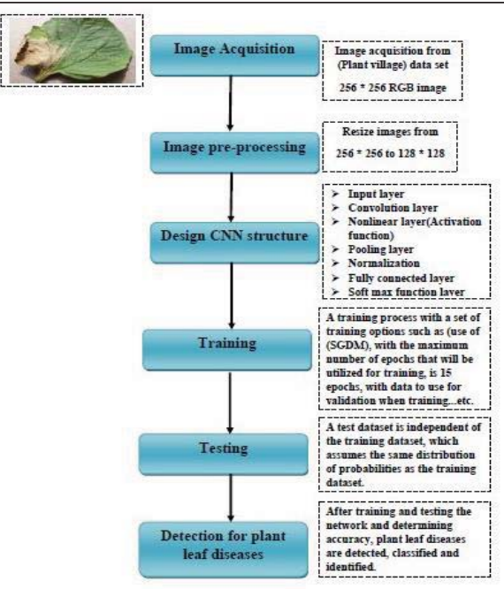
System Design for Plant Leaf Disease Detection
System Purpose: Detect and classify plant leaf diseases using deep learning.
Dataset: Plant Village with 20,636 images of tomato, pepper, and potato leaves.
Pre-process: Resize to 128x128 pixels, convert to RGB, save as uncompressed JPG.
CNN Architecture:
Layers:
Input Layer: Pixel values of images.
Convolutional Layers.
Pooling Layers: Max pooling to reduce dimensionality.
Activation Function: ReLU after each convolutional layer.
Fully Connected Layers: Dense connections to previous layers.
Normalization Layer: Batch normalization for stability.
Output Layer: Softmax for 15 class classification.
Training: 70% data for training, 30% for testing, 15 epochs, 112 iterations per epoch.
Accuracy: obtaining the accuracy for training and testing data.
Implementation: Detect diseases in new leaf images.

Slide 5
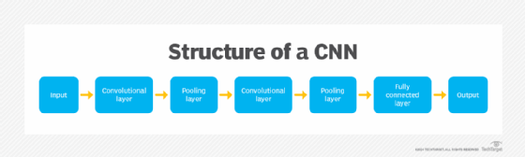
CNN Algorithm for Plant Disease Detection
Input Layer:
Accepts input images and their pixel values.
Convolution Layer:
Uses different kernels to create feature maps.
Pooling Layer:
Follows convolution layers to reduce dimensions.
Used max-pooling for dimensionality reduction.
Non-Linear Layer:
Applies Rectified Linear Units (ReLU) for non-linear transformation.
Fully Connected Layer:
Neurons in adjacent layers are fully connected.
Normalize Layer:
Uses batch normalization to reduce sensitivity to data variations.
Softmax Layer:
Applies the softmax function to classify into disease categories.

Slide 6
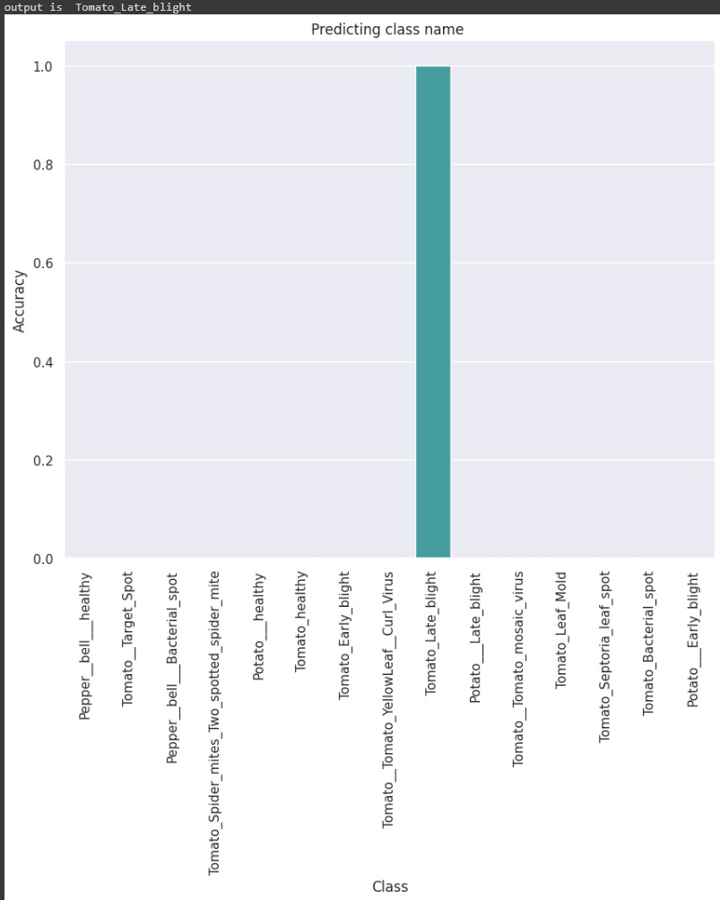
WORK FLOW
Data Acquisition
Image Preprocessing
Model Development
Model Evaluation
Deployment

Slide 7
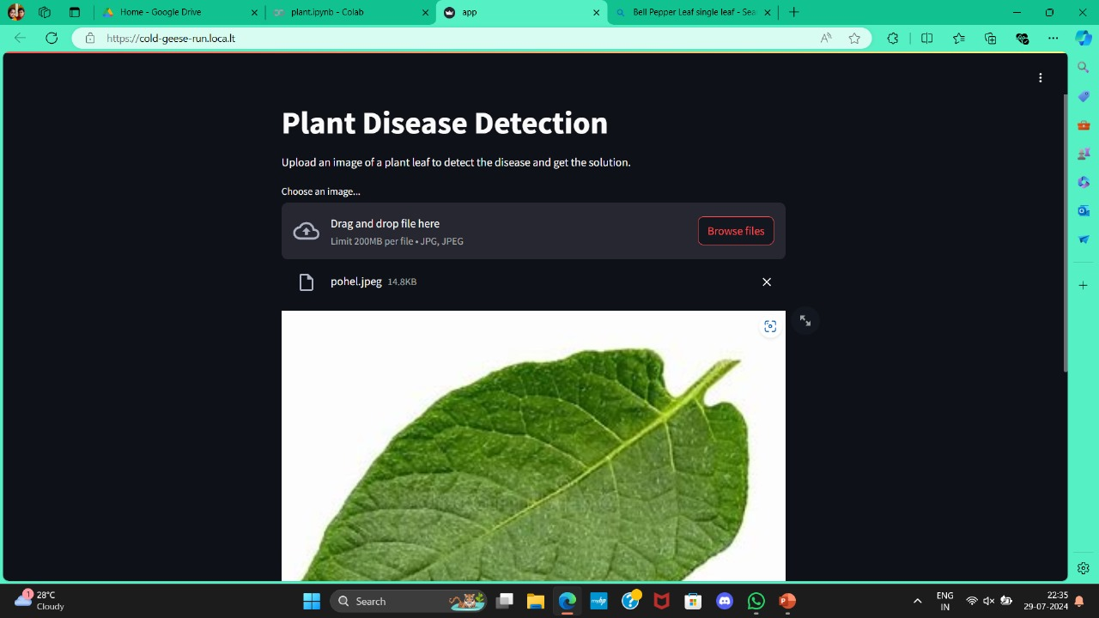
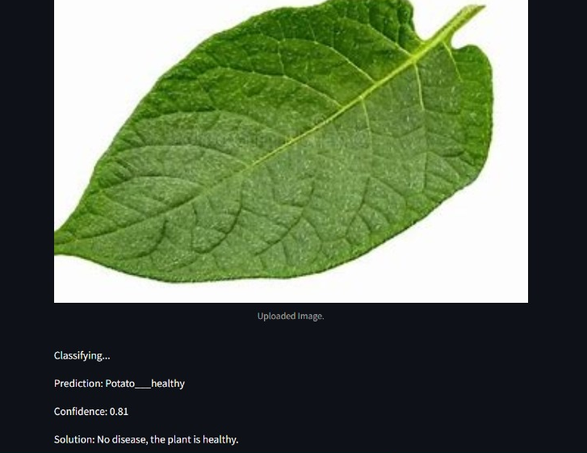
Implementation in Screens

Slide 8
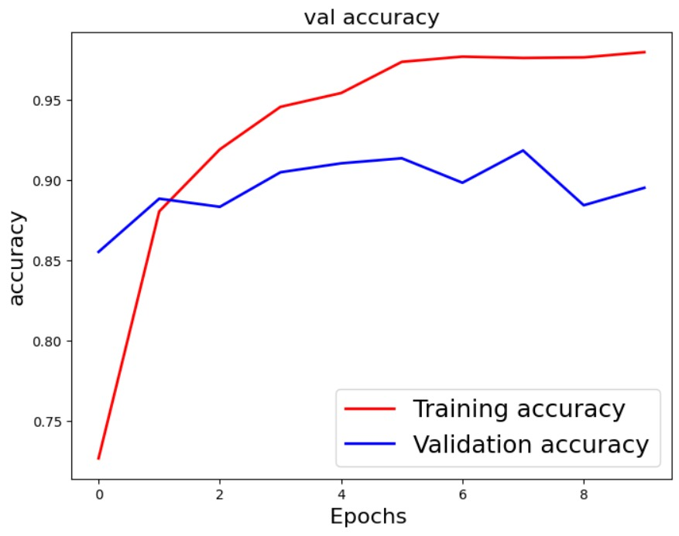
Experimental Results
Dataset Description
Total Images: 20,636
Plants: 3
Plant Diseases: 15
Data Split:
70% training (14,445 images),
30% testing (6,191 images)
Training and Validation
Training Set: 14,445 images
Testing Set: 6,191 images
Evaluation Metrics
Accuracy: 0.8953
Model Performance
Accuracy: 91.7%

Slide 9
Conclusion and References
Given the importance of agriculture and plants worldwide, and the prevalence of numerous plant diseases today, this research proposes a robust methodology to detect and classify these diseases with accurate and fast results using deep learning techniques. We conducted this work to achieve high accuracy and efficiency in identifying both the type of disease and the plant it affects, based on the plant's leaf.
Using a Convolutional Neural Network (CNN) algorithm, we obtained high accuracy results,
our research classifies fifteen different plant diseases, covering essential and internationally known plants such as tomatoes, potatoes, and peppers. Various learning rates and optimizers could also be explored in future work to further enhance the proposed system.

Slide 10


Thank you

